Slide 1


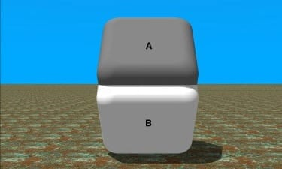
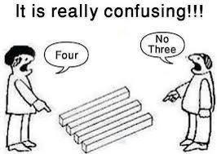
Feature Recommendation For Hotel Popularity
Lokin Sai Makkena, Sankaranarayanan, Kankanti Nithin Veer Reddy, Department of Computer Science, University of Colorado, Boulder, CO, 80309, USA
Abstract
Project Pipeline
Introduction:
The prime topic discussed here is to explore the usage of machine learning to recommend features to improve the popularity of the hotel
Motivation:
Explore the domain of feature engineering and also the correlation between the common features
Objective:
To understand which features play a major role to predict hotel popularity based on feature selection methods.
Data
Collection
Text
Cleanup
Tokenization
Speech
Tagging
Evaluation
Feature
Selection
Word
Embedding
Data Collection
Principal Component Analysis
Collected TripAdvisor ids of hotels round the globe.
We use TripAdvisor API to get the destination related info
in order to formulate the TripAdvisor web urls. Once the
web urls are available, using python beautiful soap, we
scrapped all the reviews available for a hotel.
The principal component analysis was used to find features which are contributing to have high variance. Top features which show high variance are selected. The correlation between features from PCA method were calculated.
Text Cleanup
Correlation Analysis
Pre-processed review text for each hotel by removing punctuations(except full stop) and normalizing text.
Pearson Correlation method was used to measure the association between two variables and gives the magnitude of correlation or association.
Speech Tagging
Assigning speech tag to each token with the input given as tokenized text. Conjunction(CC), Noun(NN), adjective (JJ) were the speech tags used to get features per sentence.
Text Transformation
Word2Vec a word embedding method was used to transform text to vector representation.
Feature Selection
Feature engineering and feature extraction can be really confusing
sometimes just like these illusions. Features are how the system
views the data like how your eyes view these pictures. It all depends
on how you view them. Features are the eyes through which the system views the data.
Two methods are used to find important features:
Principal Component Analysis (PCA)
Pearson Correlation
Example Trip Advisor Review
Results
Conclusion
The hotel itself was clean and (CC) the staff (NN) pleasant. (JJ)
I've had some nice nights at some lovely (JJ) hotels this was what a hilton (NN) should be and (CC) more.
Head towards copley square and (CC) check out the boston public (NN) library which is particularly beautiful (JJ) from the dartmouth street entrance.
Correlation Matrix From Pearson Coefficient
The Correlation values highlighted in the correlation matrix tells us that a strong association between features and play a major role in identifying the predictors for hotel popularity
 | beautiful | street | public | staff | hilton | store | rating
kind | 0.47 | 0.79 | 0.26 | -0.13 | 0.82 | 0.63 | 0.09
street | 0.22 | 1 | 0.39 | -0.24 | 0.83 | 0.91 | 0.39
staff | 0.62 | -0.24 | 0.55 | 1 | -0.23 | 0.08 | 0.39
hilton | 0.22 | 0.83 | 0.29 | -0.23 | 1 | 0.72 | 0.42
store | 0.42 | 0.91 | 0.59 | 0.08 | 0.72 | 1 | 0.59
stroll | 0.76 | 0.39 | 0.47 | 0.23 | 0.26 | 0.57 | 0.34
References
In the above example, we can see that the system has identified the word staff is noun and identified the word pleasant is adjective associated with staff . We are using conjunctions and to split sentences into phrases. Based on the sentiment, we try to identify whether staff is a positive feature.
From the correlation matrix, we can get the dependence of rating on various features.
Correlation Matrix From PCA
1.TripAdvisorAPI
https://developer-tripadvisor.com /content-api/documentation/
2.VaderSentiment https://pypi.org/project/vaderSentiment/2.1/
3.Principal Component Analysis
https://scikit-learn.org/stable/modules/generated/sklearn.decomposition.PCA.html
 | Staff | Boylston | Public | Hilton | Kind
staff | 1.00 | -0.05 | 0.86 | 0.56 | -0.16
boylston | -0.05 | 1.00 | 0.19 | -0.58 | 0.67
public | 0.86 | 0.19 | 1.00 | 0.28 | -0.06
hilton | 0.56 | -0.58 | 0.28 | 1.00 | -0.58
kind | -0.16 | 0.67 | -0.06 | -0.58 | 1.00

